Slide 1

School enrollement movement
Stetson Zirkelbach

Slide 2
Data options from D2P
Census Data
Data points separated by 4 years
Contains high school drop out data
No averaging
More translation needed:
SE_T025_001
FIPS: 8031000102 …
Only 2020 in d2p files
Neighborhood surveys
5 year averages
Multiple 5 year groupings available
Breaks grades into 4 year blocks for reporting purposes
No drop out data
More supporting files
More general data
Both data sets break it up into the 78 neighborhoods and we are concerned about 287 schools
(as of 2015)

Slide 3
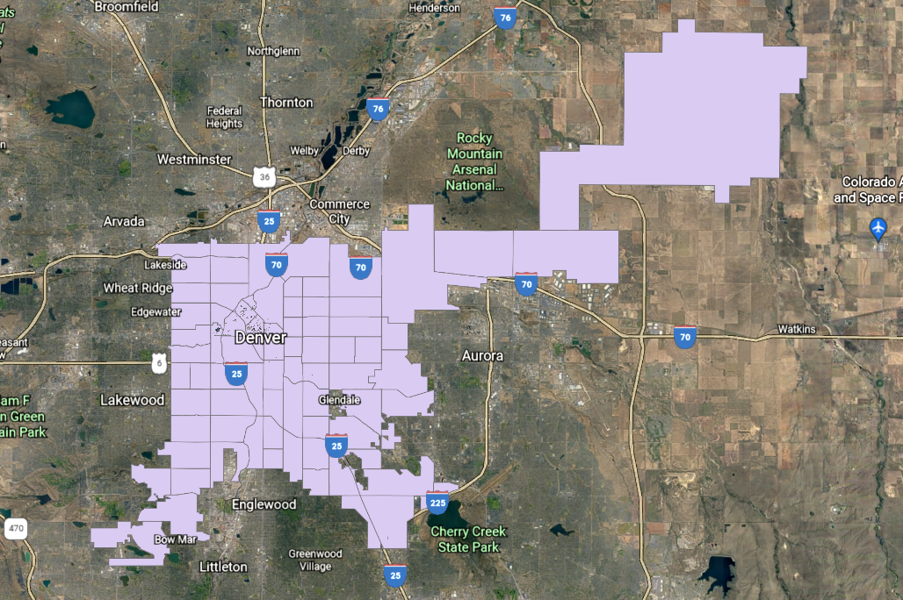

Slide 4
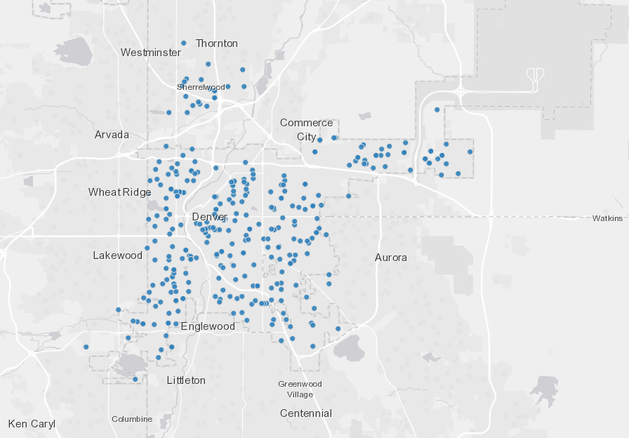

Slide 5
Project direction
Neighborhoods and schools need to be combined
Can years in the average overlap and still generate useful clusterings
The population of Denver has been growing in the years available
Our circuits will be population changes in school age kids
Looking for drops between data points or stable counts of students
The lack of school dropouts and homeschooling numbers less than ideal

Slide 6
Next steps
Neighborhood and school grouping first
Sanity check pass of the datasets once the clustering happens
Ranging passes to see how the various data sets differ to determine how many clusterings to go through and many data sets are useable

